Slide 1


Architecting Adaptive, Intelligent Systems
Autonomous Defense.
Cognitive Precision.
Joel Nelson
President & CEO

Slide 2
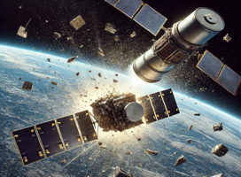
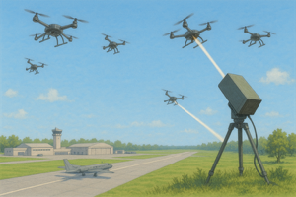
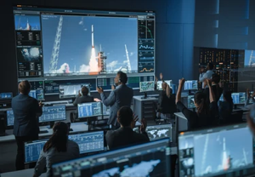
Raptor Solutions Embedded Cognitive Reasoning
Differentiating with an advanced cognitive reasoning engine for real-time situational awareness, mission adaptability, and decision-making without humans in the loop
Space Warfighting
Counter-Unmanned Aerial Systems (C-UAS)
Mission Operations and Time-Sensitive Kill Chains

Slide 3

Space Domain Awareness Gaps and Needs
Space domain awareness systems (SDA) are struggling to keep pace with the explosive growth in satellites, space debris, & adversary anti-satellite weapons.
– Gen Salzman, Chief Space Operations
Sep 2025
Impacts to the $90B commercial markets, human spaceflight, and US Space Force
Notes:
US commercial and USSF space systems have gaps in how they operate under contested and communication-degraded conditions.

Slide 4

Underlying Problem: Today’s Space Systems are Blind, Deaf, and Dumb
Space Systems rely on constant human oversight. This reliance results in massive delays in real-time reaction.
Major Problems:
Threat Classification taking hours/days
Limited autonomy in Rendezvous and Proximity Operations for on-orbit servicing
Overtasking operators
Notes:
Define the Gap
Traditional systems are sensor-centric and lack adaptive intelligence—raw data has to be downlinked, processed on Earth, and pushed back up.
This creates latency, bandwidth bottlenecks, and inability to autonomously respond to fast-moving threats or hazards.

Slide 5


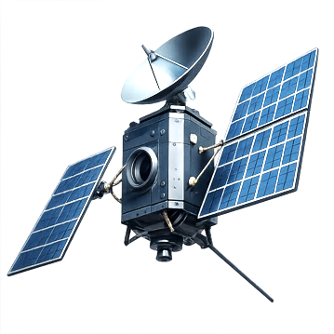

Raptor Dynamix: A new frontier in space intelligence
Raptor is building the brain that changes everything— integrating real-time data
and turning space platforms into smarter, more autonomous systems – seconds vs days
Through advanced algorithms and edge computing payloads, we will
convert existing satellites into Advanced Cognitive Reasoning Satellites
Notes:
Unlike traditional AI systems that focus solely on pattern recognition or automation, our architecture integrates real-time data with neuroscience-inspired reasoning mechanisms to deliver ethical, transparent, human-level autonomy.

Slide 6
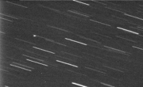
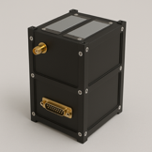
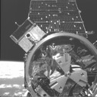
RDX Products: Enabling Real-Time Threat Detection and Response
 | SpaceGuardianTM Software | Proprietary on-orbit algorithms for real-time threat detection – seconds vs days
 | ShadowMindTM Software | Autonomy architecture to enable onboard threat response and anomaly resolution
ShadowSentinelTM Hardware | An integrated edge-computing payload for real time operations
Our product suite is ready to be the solution to the ever-changing space landscape

Slide 7

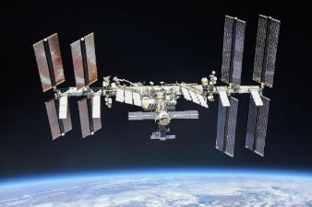
Dual-Use Market Opportunities Growth in Artificial Intelligence for Space
AI in Defense Space
Segmented Market
Payloads/Edge Computing
AI in Commercial Space
Segmented Market
Payloads/Edge Computing
$5B+
$7B+
$500M
+58.5% CAGR
$800M
+53.6% CAGR
2030
2030
2025
2025
A Non-Traditional Payload Leader
Building Out the Supply Chain for Operational Missions

Slide 8






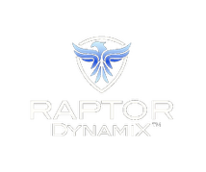

Traction US Air & Space Force
“We cannot be satisfied if it takes us hours to detect on-orbit activity…” Gen Saltzman, Chief of Space Operations
Awarded STTR
$200K
Oct 25
CRADA & Facility Clearance Award
Sep 25
Commercial Award
$500K Capital
Jul 25
Space Enterprise Consortium
April 25
Awarded SpRCO
Phase 1
Jan-Mar 25
Space Domain Awareness Tap Lab Nov 24
Est. Aug 24
Notes:
Nov 2024 – Space Systems Command (SSC) SDA Tap Lab Apollo Accelerator
Jan 2025 Award – SpRCO Prime Fusion Accelerator (Follow-on Fall 2025)
Jan 2025 – DoD’s Platform 1 Generative AI (Awardable)
Feb 2025 – Member Consortium for Space Mobility and in-space servicing, assembly, and manufacturing (ISAM) capability
April 2025 – Space Enterprise Consortium (SpEC OTA) for USSF/SSC
Jul 2025 – Won Orbital Edge and launch to the Space Station in 2027
Sep 2025 – Won 1st AFWERX/CYBERWORX STTR Program for Counter-UAS
NASA Autonomy Project – confirms RDX trusted autonomy approach
Commercial Spacecraft Manufacturers and Traditional Prime Contractors
Current Customers: US Air Force (USAF), US Space Force (USSF), CyberWorx, and Space Rapid Capabilities Office (SpRCO)

Slide 9









Traction Commercial Partnerships
“Space-based cloud infrastructure is the next frontier…to enabling AI workloads at the orbital edge.”
– Travis Steel, Chief Architect, Red Hat
$2M in bids
Nov 25
Launch to ISS
Sep 25
$9M in bids
Aug 25
$6M in bids
Discounted GPUs
Aug 25
$100K Credits
Spring 24
Hosted Payloads
Est. Aug 24

Slide 10







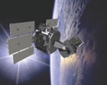






Go-to-Market Strategy MVP, Scalability, & Growth
Commercial Satellites; Space Stations; In-Space Manufacturing
Commercial Payloads
Edge Computing
$7B (2030)
Commercial
Path 2026+
Orbital Edge Pathfinder
Launch to ISS
MVP 1Q27
2026
2027
2028
2030
Expand platforms
Defense Payloads
Edge Computing
$2B (2030)
USSF
Path 2026+
Tactically Aware & Responsive Satellite
SpWERX SBIR / AFRL
ShadowMindTM
USSF Variant
ShadowSentinelTM
Customer R&D
Golden Dome
Missile Defense Agency
Edge Computing
$3B (2030)
Satellite Constellations
Space-Based Interceptor
Golden Dome
Notes:
Plan to acquire customers
Adoption of our produce/service
Path to generate leads and turn them to paying customers
Marketing, advertising, partnerships, or direct sales
Dual-use
E-commerce
Enable On-orbit sensor data processing
Multi-sensor track fusion
Counter Hypersonic
Dynamic Space Operations

Slide 11
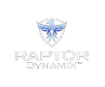









Competitive Landscape
Non-Traditional
Limited competition developing Cognitive Reasoning Engines – Raptor brings a differentiator
US Government shifting to Non-Traditional developers
Raptor Competitive Advantage
Technical Differentiation
Adaptable to Threats
Team Talent and Relationships
Customer Traction
Scalable & Upgradable
Automation
Cognitive AI & Autonomy
*Circled Companies are Partners of ours
Traditional

Slide 12
Financials AI, Edge Computing, and Payload Solutions
Path to $1M in Revenue & 10x growth
USSF new starts for Intelligent Space Systems ($6.5M+)
Space-Based Interceptor program ($3M+)
Adjacent Markets
Counter – Unmanned Aerial Systems ($2M+)
Data fusion / analytics for Operations ($2M+)
Commercial and Strategic Partnerships (e.g. Anduril and Apex)
Government R&D Awards
Revenue
2025 - $190K
2026 - $3 - 6M
2027 - $13 - 21M
2028 - $32 - 50M
$160M
$69M
Pursuit Pipeline
$27M

Slide 13














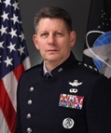

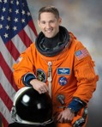
RDX Leadership
Right Team to Develop & Grow
25-years building Payloads & Satellites
Strategy & Business Development
40-years Aerospace and Artificial intelligence
Cognitive & Neural Systems (since 1990s)
Joel Nelson
President & CEO
Del Christman
VP, AI & Autonomy
Advisory Board
(being finalized)
Notes:
Founder / Leadership
Technical Leadership
Background/Strengths
Relevant expertise, experience, skills
Notable achievements or industry experience to execute the vision
Skills to scale the business and handle the challenges you will face
Seasoned, passionate, and complementary team that turns our vision into reality!

Slide 14

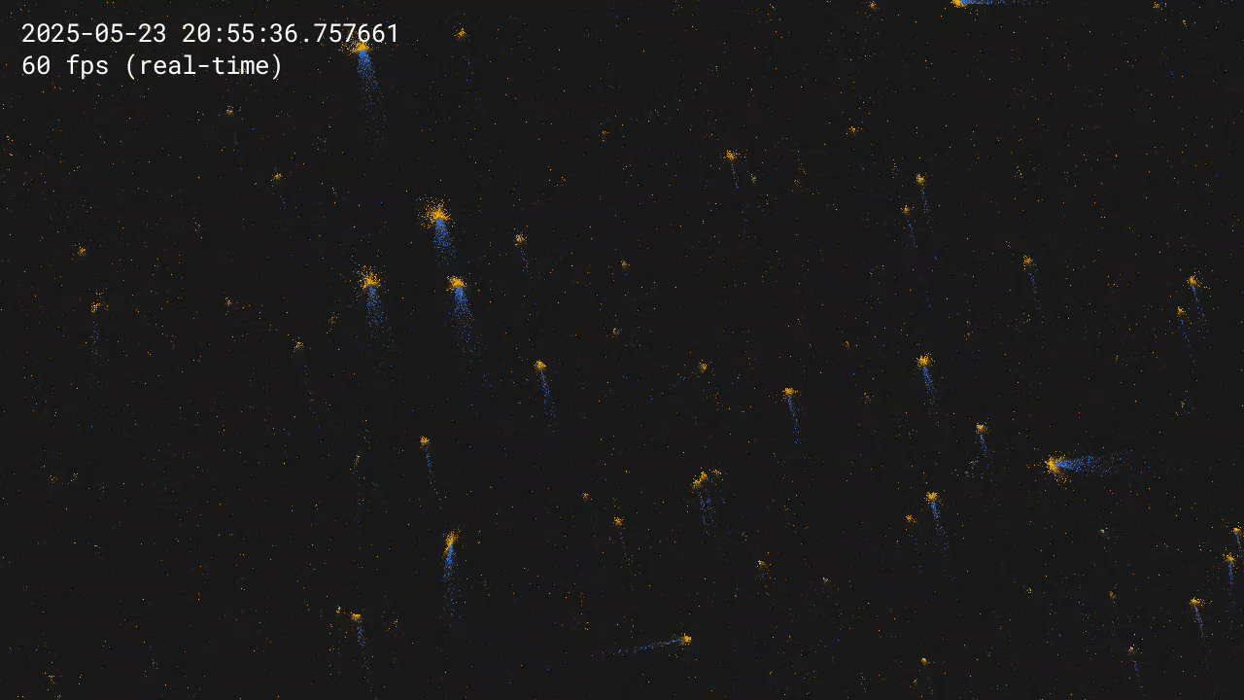
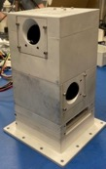


ShadowSentinel™ Pathfinder Orbital Edge
Full Motion Video
Event-based Imaging
100-1000x less data
Edge Computing GPU
Commercially deployable
NVIDIA® Jetson AGX Orin™
Processing in seconds
SpaceGuardian™
AI Algorithm suite
Deployed on-orbit
Real-time knowledge
Data collected from ISS 5/23/25
ShadowSentinel will Upgrade
Notes:
Technical Viability and Feasibility: Does the presenting team have a feasible concept of operations for the ISS? 35 points

Slide 15





Seed Raise Use of Capital and Path to MVP
Raise Allows
SpaceGuardian™ Algorithms ($350k)
Onboard AI Developer
Develop & Test Algorthims
ShadowSentinel™ Payload ($500k)
Onboard Payload Engineer
Payload Development
Go-to-Market Activities ($150k)
Marketing / Advisors
Develop Opportunities
Dec 25
Summer 26
Fall 26
SpaceGuardian™ Algorithms
(Dec + 8 months)
Objective 1: Simulation-Based Training Objective 2: Algorithm Optimization
ShadowSentinel™ Pathfinder MVP
2027
ShadowSentinel™ Payload
(Jan + 10 months)
Objective 3: Integrate Payload
USSF/SpRCO Payload for On-Orbit Threat Detection (GEO)
2026-2027
Radiation Harden ShadowSentinel™
2028

Slide 16
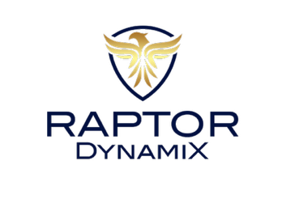
Joel Nelson
www.raptordynamix.us
Joel.nelson@raptordynamix.us
719-429-7463

Slide 17


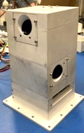
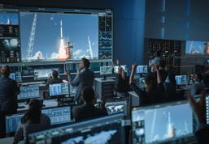
Business Model AI, Edge Computing, and Payload Solutions
Four distinct revenue streams will allow for us to succeed in market capture
License Model for AI Algorithms
SpaceGuardianTM will generate revenue through subscription services (as developed or annual pricing), licensing, and/or data services for space threat alerts.
Recurring -- $25M/yr by 2029
Maintenance (Mx) and Update Subscription to Models
Software can learn and be updated
Recurring -- $10M/yr by 2029
Sales for Threat Detection and Autonomy Payloads
ShadowSentinelTM – Cognitive Autonomy Engine and Edge Computing payload for any spacecraft
Payload Development -- $50M/yr by 2029
Operations & Predictive Analytic Services ($25M/yr)
Notes:
How we make money – generate revenue
Monetize its product
Pricing strategy; customer acquisition cost and lifetime value
Plans to scale and diversify products

Slide 18
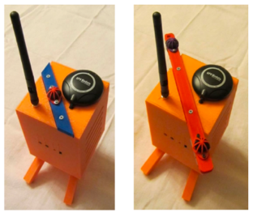
RaptorEyeTM Counter–Unmanned Aerial Systems (C-UAS)
A C-UAS detection system (TRL7) acoustically detects UAS threats which provides a scalable, low-cost counter-UAS detection layer for defense and critical infrastructure
Operations Gaps
RaptorEye in Operations
RaptorEyeTM Prototype
Avoid Operational Surprise from UAS Swarms
Identify Threats Early in Cluttered Environments
Cognitive Artificial intelligence for responsible autonomy

Slide 19


FusionEdgeTM Data Fusion, Threat Detection, and Decision-Making
Proliferated Warfighter Space Architecture
Real-time ingestion and fusion of data from PWSA space systems
Deploying AI/ML-driven analytics for anomaly detection, threat identification, and predictive situational awareness
Enabling real-time tasking, automated decision-making, and timely kill chain

